Slide 1
Data Preprocessing

Slide 2
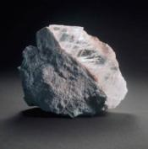
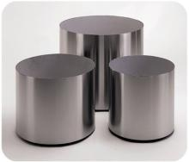
Outline
Data Cleansing
Data Transformation
Data Description
Feature Selection
Feature Extraction

Slide 3
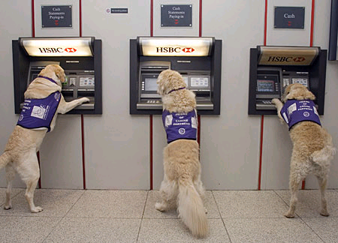

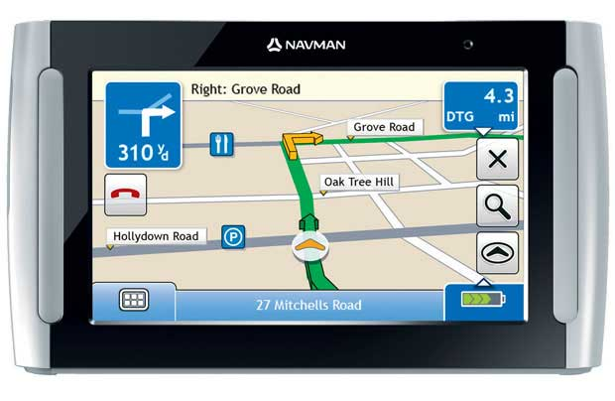

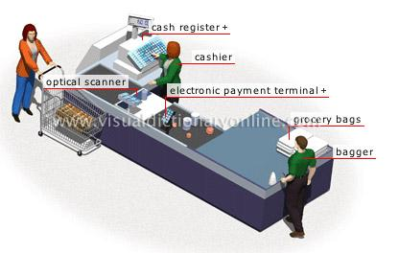
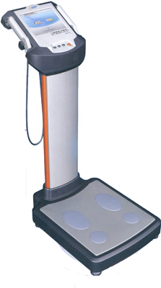
Where are data from?

Slide 4

Why Data Preprocessing?
Real data are notoriously dirty!
The biggest challenge in many data mining projects
Incomplete
Occupancy = “ ”
Noisy
Salary = “-100”
Inconsistent
Age = “42” vs. Birthday = “01/09/1985”
Redundant
Too much data or too many features for analytical analysis
Others
Data types
Imbalanced datasets

Slide 5

Missing Data
Data are not always available.
One or more attributes of a sample may have empty values.
Many data mining algorithms cannot handle missing values directly.
May cause significant troubles.
Possible Reasons
Equipment malfunction
Data not provided
Not Applicable (N/A)
Different Types
Missing completely at random
Missing conditionally at random
Not missing at random

Slide 6

How to handle missing data?
Ignore
Remove samples/attributes with missing values
The easiest and most straightforward way
Work well with low missing rates
Fill in the missing values manually
Recollect the data
Domain knowledge
Tedious/Infeasible
Fill in the missing values automatically
A global constant
The mean or median
Most probable values
More art than science

Slide 7
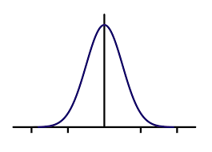
Missing Data: An Example
P(Y|X)
M_Y
Y
M_Y
M_Y
X

Slide 8
Outliers
Outliers
y
y = x + 1
x

Slide 9

Outliers
Outliers

Slide 10
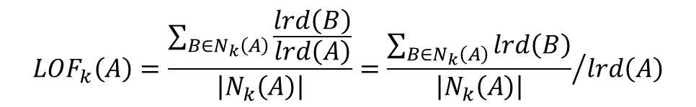
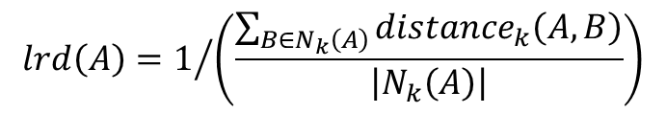
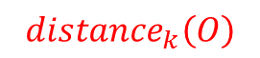
Local Outlier Factor
$${distance}_{k}\left(O\right)$$
k=3
p₂
o
p₁
$${distance}_{k}\left(A,B\right)=max\left\{{distance}_{k}\left(B\right),d\left(A,B\right)\right\}$$
p₃
p₄
$$lrd\left(A\right)=1/{\left(\frac{\sum_{B∈N_{k}\left(A\right)}{{distance}_{k}\left(A,B\right)}}{\left|N_{k}\left(A\right)\right|}\right)}$$
$${LOF}_{k}\left(A\right)=\frac{\sum_{B∈N_{k}\left(A\right)}{\frac{lrd\left(B\right)}{lrd\left(A\right)}}}{\left|N_{k}\left(A\right)\right|}={\frac{\sum_{B∈N_{k}\left(A\right)}{lrd\left(B\right)}}{\left|N_{k}\left(A\right)\right|}}/{lrd\left(A\right)}$$

Slide 11
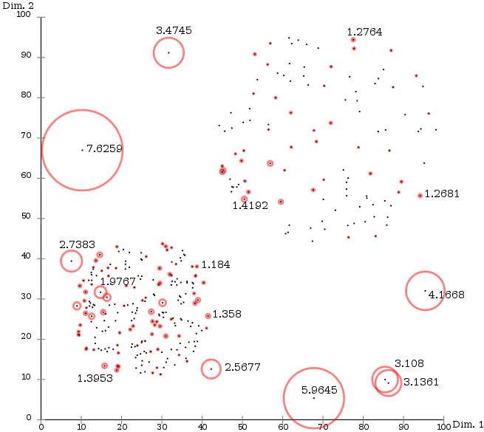
Local Outlier Factor

Slide 12
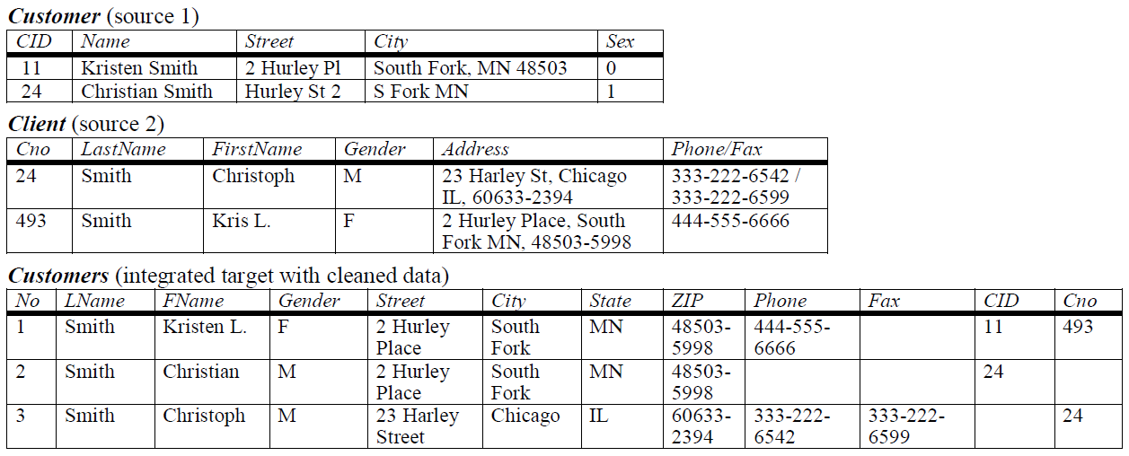
Duplicate Data

Slide 13
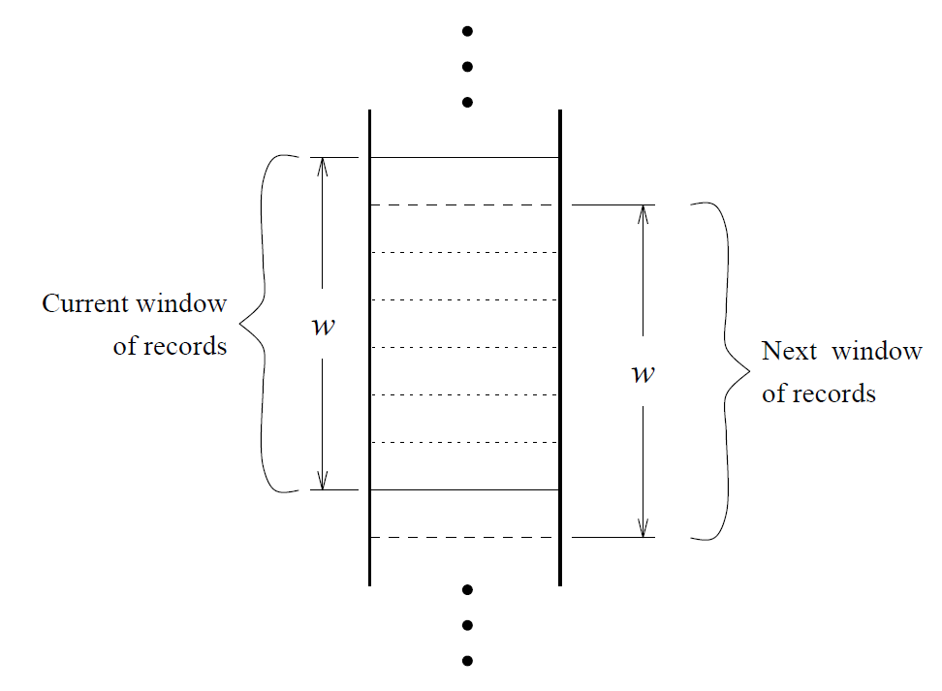
Duplicate Data

Slide 14
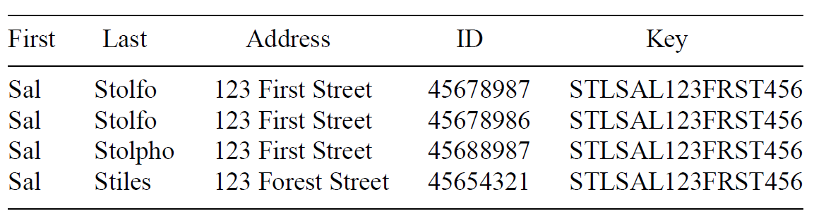
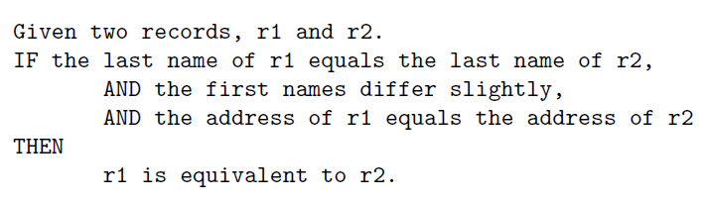
Duplicate Data
Create Keys
Sort
Merge

Slide 15
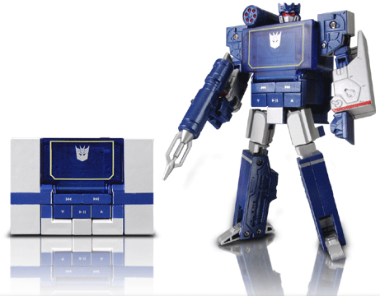
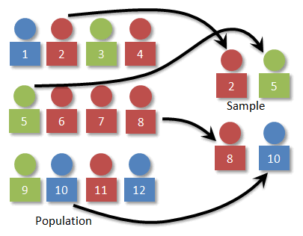
Data Transformation
Now we have an error free dataset.
Still needs to be standardized.
Type Conversion
Normalization
Sampling

Slide 16
Attribute Types
Continuous
Real values: Temperature, Height, Weight …
Discrete
Integer values: Number of people …
Ordinal
Rankings: {Average, Good, Best}, {Low, Medium, High} …
Nominal
Symbols: {Teacher, Worker, Salesman}, {Red, Green, Blue} …
String
Text: “Tsinghua University”, “No. 123, Pingan Avenue” …

Slide 17
Type Conversion
×
○
×
×
○
×
Size
○
×
○
○
×
○
Color

Slide 18
Type Conversion
×
×
○
×
×
○
Size
○
○
×
○
○
×
Color

Slide 19
Type Conversion
0 0 0 1
0 0 1 0
0 1 0 0
1 0 0 0

Slide 20
Sampling
A database/data warehouse may store terabytes of data.
Processing limits: CPU, Memory, I/O …
Sampling is applied to reduce the time complexity.
In statistics, sampling is applied often because obtaining the entire set of data is expensive.
Aggregation
Change of scale:
Cities → States; Days → Months
More stable and less variability
Sampling can be also used to adjust the class distributions.
Imbalanced dataset

Slide 21
Imbalanced Datasets
LHS RHS
10%
5%
85%
Classifier A
Classifier B

Slide 22
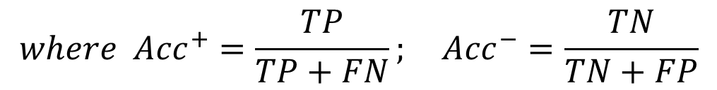
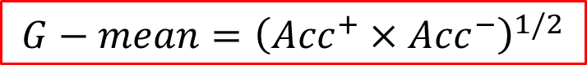
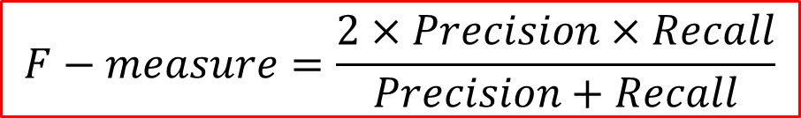
Imbalanced Datasets
$$G−mean={\left({Acc}^{+}×{Acc}^{−}\right)}^{1/2}$$
$$where {Acc}^{+}=\frac{TP}{TP+FN}; {Acc}^{−}=\frac{TN}{TN+FP}$$
$$F−measure=\frac{2×Precision×Recall}{Precision+Recall}$$
$$where Precision=\frac{TP}{TP+FP}; Recall=\frac{TP}{TP+FN}={Acc}^{+}$$

Slide 23
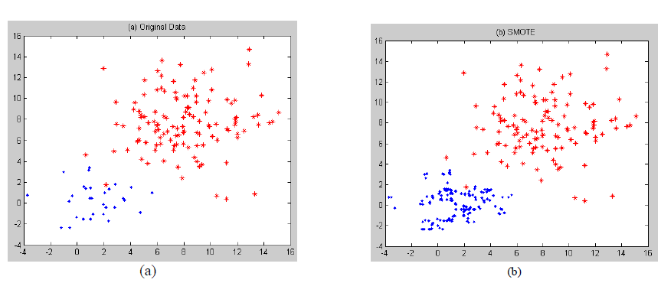
Over-Sampling
SMOTE

Slide 24
Boundary Sampling

Slide 25
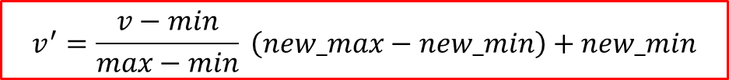
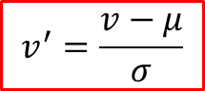
Normalization
The height of someone can be 1.7 or 170 or 1700 …
Min-max normalization:
Let income range $12,000 to $98,000 be normalized to [0.0, 1.0]. Then $73,600 is mapped to
Z-score normalization (μ: mean, σ: standard deviation):
（infinite）
Let μ = 54,000, σ = 16,000. Then
$$v^{′}=\frac{v−min}{max−min} \left(new_max−new_min\right)+new_min$$
$$v^{′}=\frac{v−μ}{σ}$$

Slide 26
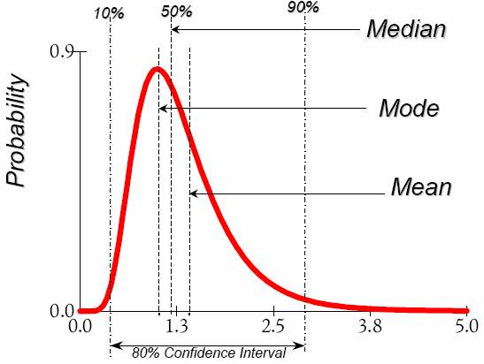
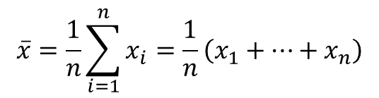
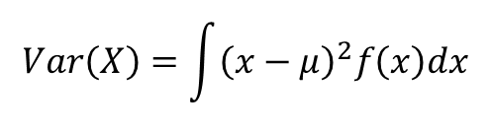
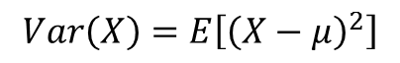
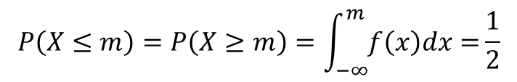
Data Description
Mean
Arithmetic mean
Median
Mode
The most frequently occurring value in a list
Can be used with non-numerical data.
Variance
Degree of diversity
$$\overline{x}=\frac{1}{n}\sum_{i=1}^{n}{x_{i}}=\frac{1}{n}\left(x_{1}+…+x_{n}\right)$$
$$P\left(X≤m\right)=P\left(X≥m\right)=\int_{−∞}^{m}{f\left(x\right)dx=}\frac{1}{2}$$
$$Var\left(X\right)=\int{{\left(x−μ\right)}^{2}f\left(x\right)dx}$$
$$Var\left(X\right)=E\left[{\left(X−μ\right)}^{2}\right]$$

Slide 27
Data Description
Pearson’s product moment correlation coefficient
If r_{A, B} > 0, A and B are positively correlated.
If r_{A, B} = 0, no linear correlation between A and B.
If r_{A, B} < 0, A and B are negatively correlated.

Slide 28
Data Description
Pearson's chi-square (χ²) test
 | Play chess | Not play chess | Sum (row)
Like science fiction | 250 (90) | 200 (360) | 450
Not like science fiction | 50 (210) | 1000 (840) | 1050
Sum (col.) | 300 | 1200 | 1500

Slide 29
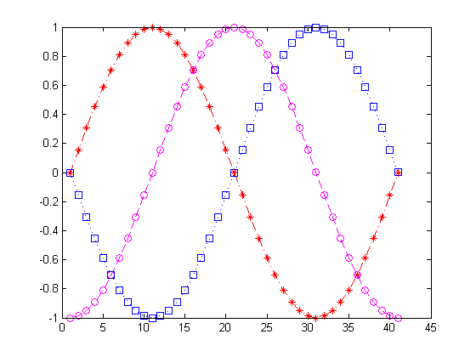
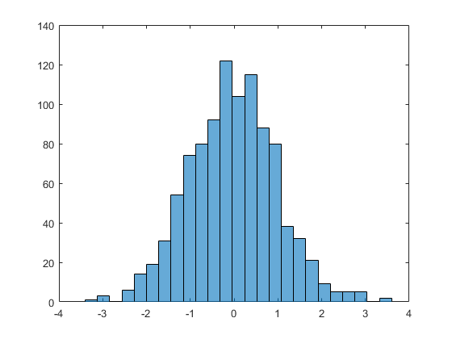
Data Visualization (1D)

Slide 30
Data Visualization (2D)
Notes:
load carsmall
plot(Displacement, Acceleration,'ro')
regress(Acceleration,[ones(100,1),Displacement])
hold on
line([0,19.35/0.021],[19.35,0])

Slide 31
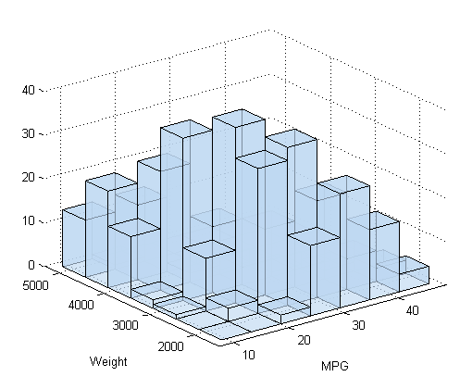
Surf Plots (3D)
Notes:
[X,Y]=meshgrid(-3:0.1:3,-3:0.1:3);
Z=peaks(X,Y);
surfc(X,Y,Z);
shading interp
colormap(gray);

Slide 32
Box Plots (High Dimensional)
Notes:
S=diag([1,2,0.5,1])
M=[0,1,3,-1];
Z=mvnrnd(M,S,10000);
boxplot(Z);

Slide 33
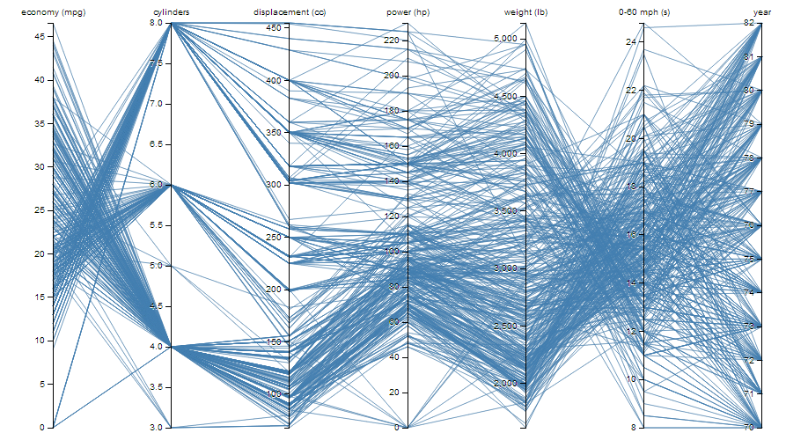
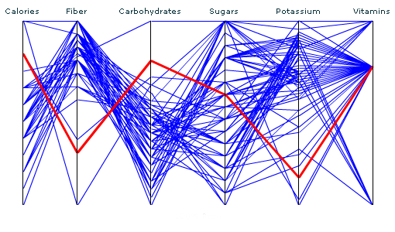
Parallel Coordinates (High Dimensional)

Slide 34
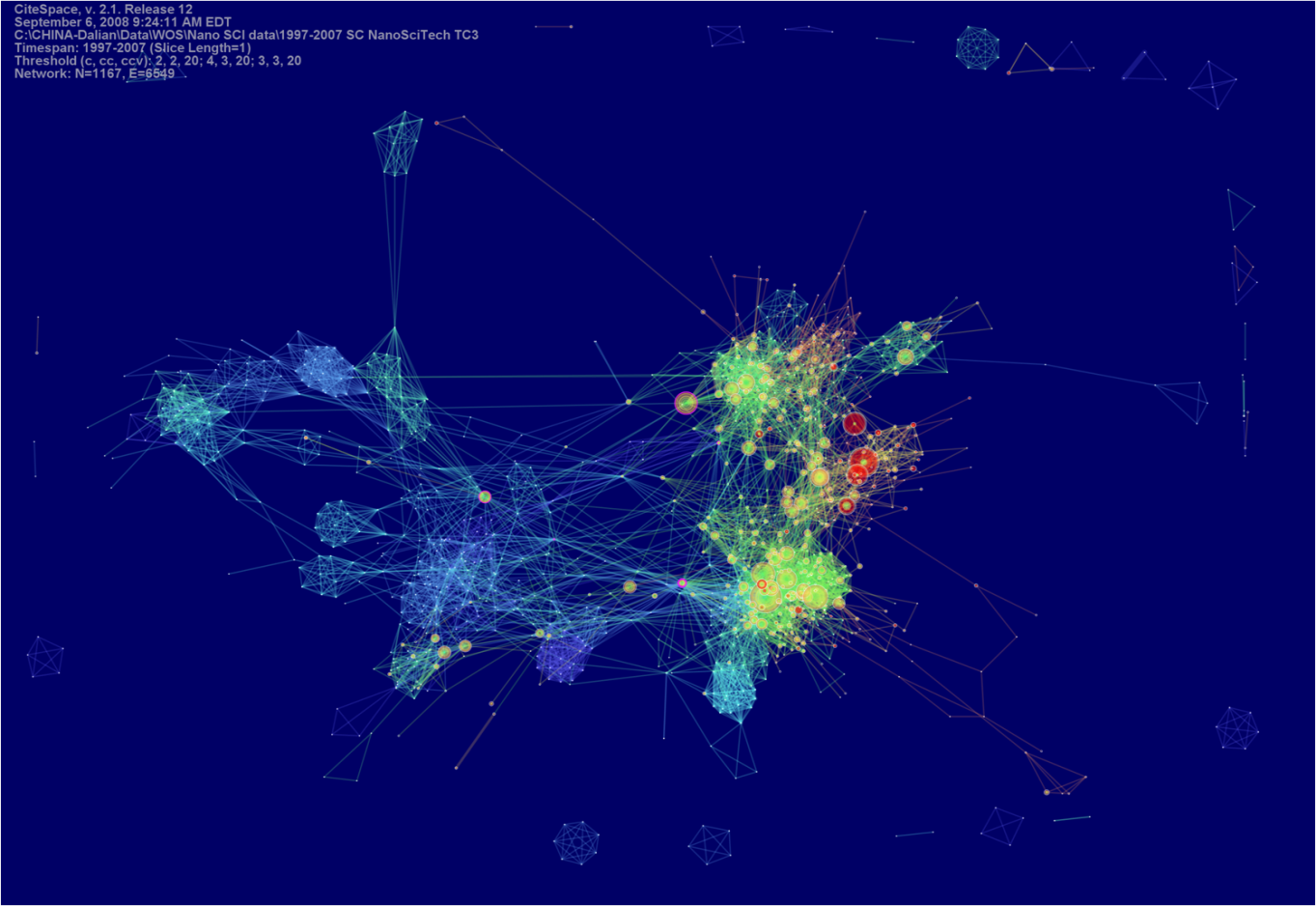
CiteSpace

Slide 35
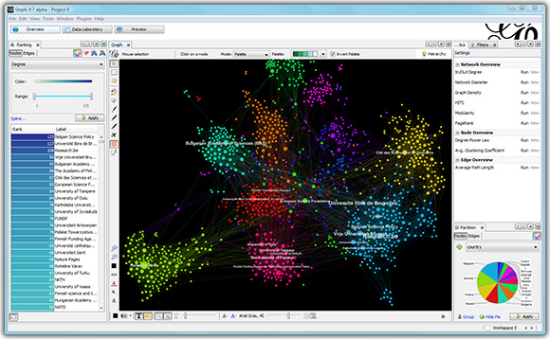
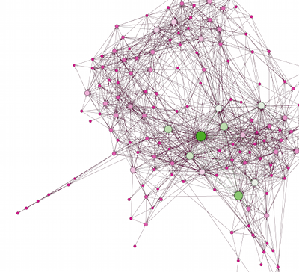
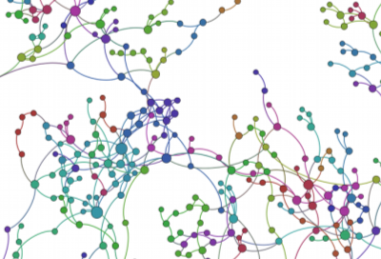
Gephi

Slide 36
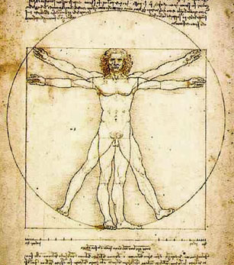
Feature Selection
ID
Weight
Age
Noisy?
Gender
Height
Irrelevant?
Education
Duplicate?
Income
Address
Complexity?
Location
Occupation

Slide 37
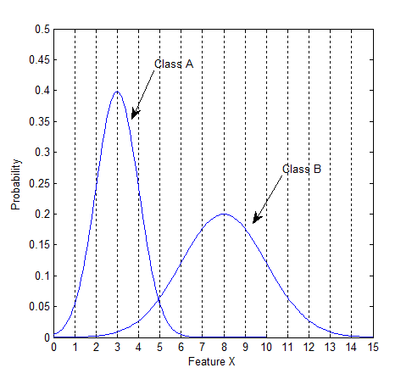
Class Distributions

Slide 38
Class Distributions

Slide 39
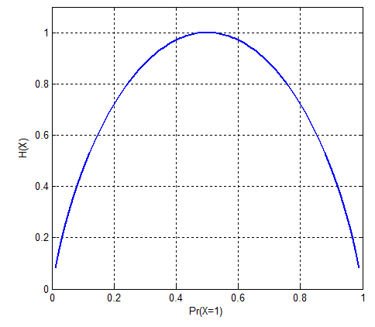
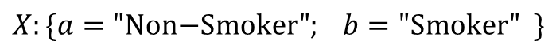
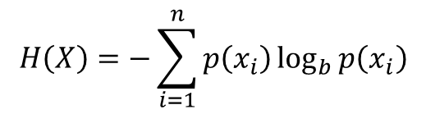
Entropy
$$H\left(X\right)=−\sum_{i=1}^{n}{p\left(x_{i}\right)\log_{b}{p\left(x_{i}\right)}}$$
$$X:\{a="\text{Non}\text{−}\text{Smoker}"; b=\text{"}\text{Smoker}" \}$$
Information Gain
Notes:
a: Non-Smoker (60%) 80% Female 20% Male
b: Smoker (40%) 5% Female 95% Male

Slide 40
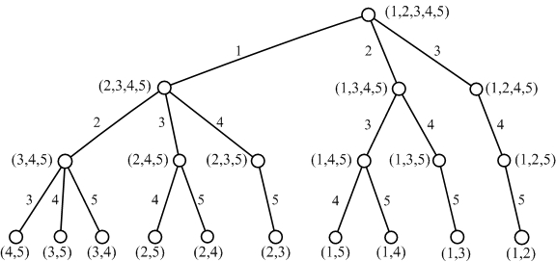
Feature Subset Search
Exhaustive
All possible combinations
Branch and Bound

Slide 41

Feature Subset Search
Top K Individual Features
Sequential Forward Selection
Sequential Backward Selection
Optimization Algorithms
Simulated Annealing
Tabu Search
Genetic Algorithms

Slide 42

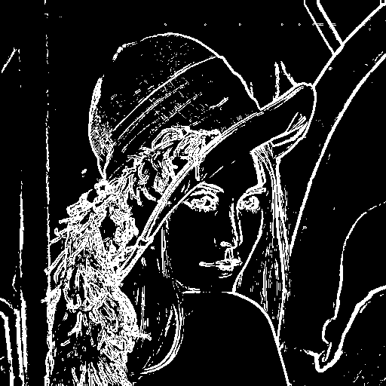
Feature Extraction

Slide 43

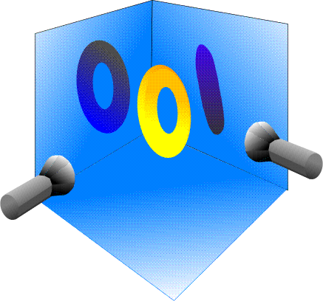
Principal Component Analysis

Slide 44
2D Example
Data: Gaussian Distribution
Variance: Information
Ellipse: Major Axis vs. Minor Axis
Select the attribute corresponding to the Major Axis.
Minor
Major
Feature X₂
Feature X₁

Slide 45
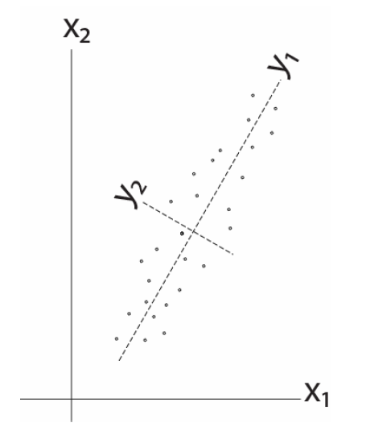
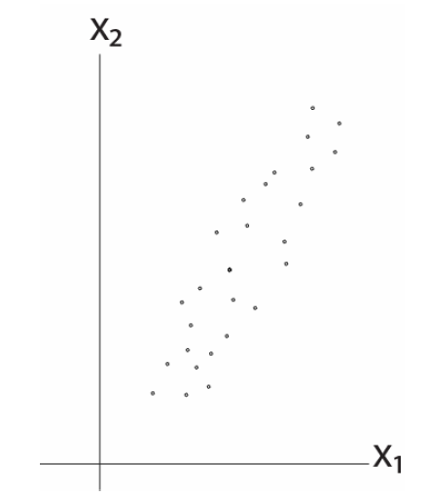
2D Example

Slide 46
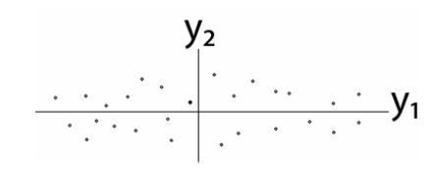
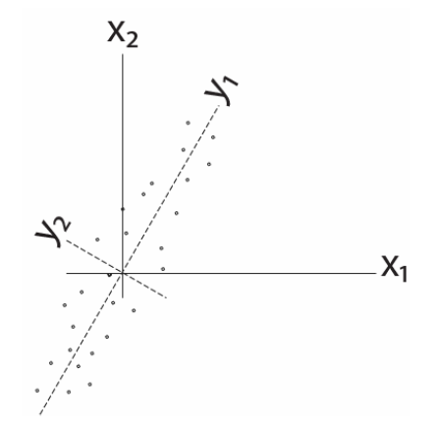
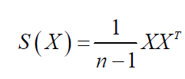

2D Example
Remove correlation

Slide 47


Matrix 空间变换

Slide 48


Matrix 行列式

Slide 49


Matrix 行列式

Slide 50


Matrix 逆矩阵

Slide 51


Matrix 基变换

Slide 52


Matrix 基变换

Slide 53


Slide 54


Eigenvector

Slide 55


Eigenvector

Slide 56

SigularValue Decomposition

Slide 57

SigularValue Decomposition

Slide 58


SVD 两种角度

Slide 59


SigularValue Decomposition

Slide 60

SigularValue Decomposition

Slide 61
PCA
Remove correlation

Slide 62






Some Math
Goal: S(Y) has nonzero diagonal entries and all off-diagonal elements are zero.
Eigendecomposition

Slide 63












A Different View
$$x_{k}$$
e
$$J\left(e\right)=\sum_{i=1}^{n}{{\left\|{x_{k}^{}}^{′}−x_{k}\right\|}^{2}}$$
$$α_{k}=e^{t}x_{k}$$
$${x_{k}^{}}^{′}$$
$$\left\|e\right\|=1$$
$$=\sum_{i=1}^{n}{{\left\|α_{k}e−x_{k}\right\|}^{2}}$$
$$α_{k}$$
$$=\sum_{i=1}^{n}{{α_{k}}^{2}{\left\|e\right\|}^{2}}−2\sum_{i=1}^{n}{α_{k}e^{t}x_{k}}+\sum_{i=1}^{n}{{\left\|x_{k}\right\|}^{2}}$$
$$=−\sum_{i=1}^{n}{{α_{k}}^{2}}+\sum_{i=1}^{n}{{\left\|x_{k}\right\|}^{2}}$$
$$\max_{e}{e^{t}Se s.t. \left\|e\right\|=1}$$
$$=−\sum_{i=1}^{n}{e^{t}x_{k}{x_{k}^{}}^{t}e}+\sum_{i=1}^{n}{{\left\|x_{k}\right\|}^{2}}$$
$$S=\sum_{i=1}^{n}{x_{k}{x_{k}^{}}^{t}}$$

Slide 64


Lagrange Multipliers

Slide 65


More Math ...
eigenvector
eigenvalue
PCA
To project the original data to the eigenvectors of S with the largest eigenvalues.
$$\left[\begin{matrix}2 & 1 \\ 1 & 2\end{matrix}\right]\left[\begin{matrix}1 \\ 1\end{matrix}\right]=\left[\begin{matrix}3 \\ 3\end{matrix}\right]=3\left[\begin{matrix}1 \\ 1\end{matrix}\right]$$
$$\left[\begin{matrix}2 & 1 \\ 1 & 2\end{matrix}\right]\left[\begin{matrix}1 \\ −1\end{matrix}\right]=\left[\begin{matrix}1 \\ −1\end{matrix}\right]$$

Slide 66


PCA Examples

Slide 67
奇异值分解(Singular value decomposition)
X^{T}X be a rank (秩) r, square, symmetric m*m matrix.
PCA:

Slide 68
PCA (EVD & Vs. SVD)

Slide 69


PCA (EVD & Vs. SVD) 求解方法
PCA
PCA-SVD

Slide 70


PCA (EVD & Vs. SVD) 二者关系

Slide 71

PCA (EVD & Vs. SVD) 二者关系

Slide 72





Fish

Slide 73


Fish

Slide 74

The Issue of PCA
Now, let’s consider class information ...

Slide 75

Linear Discriminant Analysis
The objective of LDA is to perform dimension reduction while preserving as much of the class discriminatory information as possible.
Given a set of d-D vectors x₁, x₂, ..., x_{n} of which N₁ belong to ω₁, and N₂ to ω₂. Of all the possible projection lines y=w^{T}x, find the one that maximizes the separability.

Slide 76


Measure of Separability

Slide 77


Fisher Criterion
Maximize the distance between classes
Minimize the scatter within each class

Slide 78






Some Math …
between-class scatter
within-class scatter

Slide 79


More Math...
generalized Rayleigh quotient

Slide 80

More Math...
eigenvector problem!
scalar

Slide 81

LDA Example
Dataset
$C1=\left[\left(1,2\right);\left(2,3\right);\left(3,3\right);\left(4,5\right);(5,5)\right]$
$C2=\left[\left(1,0\right);\left(2,1\right);\left(3,1\right);\left(3,2\right);\left(5,3\right);(6,5)\right]$
Covariance of [c1; c2]
$Z=\left[\begin{matrix}2.7636 & 2.2545 \\ 2.2545 & 3.0182\end{matrix}\right]$
Eigenvectors and Eigenvalues of Z
$V=\left[\begin{matrix}−0.7268 & 0.6869 \\ 0.6869 & 0.7268\end{matrix}\right]$
$D=\left[\begin{matrix}0.6328 & 0 \\ 0 & 5.1490\end{matrix}\right]$
The direction of PCA projection: ${\left[0.6869, 0.7268\right]}^{T}$

Slide 82

LDA Example
The mean of each class
$μ_{1}=mean\left(c1\right)={\left[3.0, 3.6\right]}^{T}$
$μ_{2}=mean\left(c2\right)={\left[3.3, 2.0\right]}^{T}$
$S_{B}={\left(μ_{1}−μ_{2}\right)\left(μ_{1}−μ_{2}\right)}^{T}$=$\left[\begin{matrix} 0.11 & −0.53 \\ −0.53 & 2.56\end{matrix}\right]$
The scatter of each class
$S_{1}=4×cov\left(c1\right)=\left[\begin{matrix}10 & 8 \\ 8 & 7.2\end{matrix}\right]$
$S_{2}=5×cov\left(c2\right)=\left[\begin{matrix}17.3 & 16 \\ 16 & 16\end{matrix}\right]$
$S_{w}=S_{1}+S_{2}=\left[\begin{matrix}27.3 & 24 \\ 24 & 23.2\end{matrix}\right]$

Slide 83

LDA Example
${S_{w}}^{−1}S_{B}=\left[\begin{matrix}0.26 & −1.27 \\ −0.30 & 1.42\end{matrix}\right]$
Eigenvectors and Eigenvalues of ${S_{w}}^{−1}S_{B}$
$V=\left[\begin{matrix}−0.98 & 0.67 \\ −0.20 & −0.75\end{matrix}\right]$
$D=\left[\begin{matrix}0 & 0 \\ 0 & 1.69\end{matrix}\right]$
The direction of LDA projection: ${\left[0.6656, −0.7463\right]}^{T}$
Alternatively
${S_{w}}^{−1}{\left(μ_{1}−μ_{2}\right)}^{T}={\left[−0.7936, 0.8899\right]}^{T}$
After normalization: ${\left[−0.6656, 0.7463\right]}^{T}$

Slide 84
LDA Example

Slide 85

C-Class LDA

Slide 86
C-Class LDA
For C-class LDA with C=2, S_{B} is defined as:

Slide 87

LDA

Slide 88
C-Class LDA
N1=1000; N2=500; N3=2000;
X1=mvnrnd([0,0], [1,0;0,1], N1);
X2=mvnrnd([3,6], [1,-0.8;-0.8,1], N2);
X3=mvnrnd([10,6], [1,0.8;0.8,1], N3);
S1=(N1-1)*cov(X1); S2=(N2-1)*cov(X2); S3=(N3-1)*cov(X3);
Sw=S1+S2+S3;
M1=mean(X1); M2=mean(X2); M3=mean(X3);
Mu=(N1*M1+N2*M2+N3*M3)/(N1+N2+N3);
Sb=N1*(M1-Mu)'*(M1-Mu)+N2*(M2-Mu)'*(M2-Mu) +N3*(M3-Mu)'*(M3-Mu);
J=inv(Sw)*Sb; [V,D]=eig(J);

Slide 89



Limitations of LDA
LDA produces at most C-1 projections
S_{B} is a matrix with rank C-1 or less.
S_{W} may be singular.
LDA does not work well when ...

Slide 90

PCA VS. LDA

Slide 91
Reading Materials
M. A. Hernandez and S. J. Stolfo, “Real-World Data is Dirty: Data Cleansing and The Merge/Purge Problem,” Data Mining and Knowledge Discovery, vol. 2, pp. 9–37, 1998.
A. Donders, G. van der Heijden, T. Stijnen, and K. Moons, “Review: A Gentle Introduction to Imputation of Missing Values,” Journal of Clinical Epidemiology, vol. 59, pp. 1087-1091, 2006.
N. V. Chawla, K. W. Bowyer, L. O. Hall and W. P. Kegelmeyer, “SMOTE: Synthetic Minority Over-Sampling Technique,” Journal of Artificial Intelligence Research, vol. 16, pp. 321–357, 2002.
N. Japkowicz and S. Stephen, “The Class Imbalance Problem: A Systematic Study,” Intelligent Data Analysis, vol. 6, pp. 429–449, 2002.
D. Keim, “Information Visualization and Visual Data Mining,” IEEE Transactions on Visualization and Computer Graphics, vol. 8, pp. 1-8, 2002.
PCA Tutorials
http://www.cs.princeton.edu/picasso/mats/PCA-Tutorial-Intuition_jp.pdf
http://www.cs.otago.ac.nz/cosc453/student_tutorials/principal_components.pdf
Lagrange Multipliers
http://diglib.stanford.edu:8091/~klein/lagrange-multipliers.pdf

